Slide 1
RESTAURANT RECOMMENDATION SYSTEM
170030472 – J.Lakshmi Sai Pushkala
170030561 – Kapa Kushwanth
170031125 – R.Naga Swetha Anogini

Slide 2
Contents
Aim of Project
Introduction
Existing Technology
Proposed System
Scope
Methodology
Pseudo Code
Results
Conclusion

Slide 3
AIM OF PROJECT
The main aim of this project is to build a restaurant recommendation system that provides personalized restaurant recommendations(such as ambience, type of food, taste of the food, etc) to users based on his priorities.
Since different people have different food preferences and dietary restrictions, we perform careful feature selection to take advantage of the information reflected in a user’s reviews.

Slide 4
INTRODUCTION
Recommender Systems or Recommendation Systems are simple algorithms that provide the most relevant and accurate items to the user by filtering useful stuff from a huge pool of information base.
Recommendation engines discover data patterns in the data set by learning consumers’ choices and produces the outcomes that co-relates to their needs and interests.
Our project is to develop similar recommendation system related to restaurants.

Slide 5
EXISTING TECHNOLOGY
While many existing recommender systems mainly target individuals, there is a remarkable increase of recommender systems which generate suggestions for groups.
Group scenarios are especially popular in the food domain in which a group of people make a party or simply have a meal together.
However, the complexity significantly increases when food recommender systems need to take into account the preferences of all group members and strategies for achieving the consensus within group members.

Slide 6
PROPOSED SYSTEM
In this system, we develop a restaurant recommendation system using the Latent Factor Collaborative Filtering Optimization.
This system recommends restaurants for users or group of users based on their preferences such as beautiful ambience, good food, tasteful desserts and so.
This system provides personalized restaurant recommendations to users.

Slide 7
SCOPE
Restaurant Recommendation Systems has a wide scope in the future. At present, there are few food delivery applications which take help of the restaurant recommendation systems. There is a necessary scope in increasing the efficiency of the system.
The scope of the application is as that: The restaurants and hotels within the valley will be listed in the application.

Slide 8
METHODOLOGY
This system doesn’t require description of the data hence it recommends without knowing anything about the products.
Collaborative filtering is the type of recommendation algorithm that bases its predictions and recommendations on the rating or behavior of other users in the system. The fundamental idea of collaborative filtering is to find other users in the community that share opinions.
There are two popular approaches of collaborative filtering:
1. User-based approach
2. Item-based approach

Slide 9
Matrix Factorization or Latent Factor Collaborative Filtering
Matrix factorization is a class of collaborative filtering algorithms used in recommender systems.
Matrix factorization algorithms work by decomposing the user-item interaction matrix into the product of two lower dimensionality rectangular matrices.
A Recommendation System is an information filtering system that seeks to predict the rating a user would give for the item (in this case a restaurant). We can break down the large matrix of ratings from users and items into two smaller matrixes of user-feature and item-feature.

Slide 10
PSEUDO CODE
#matrix_factorization
def matrix_factorization(R, P, Q, steps=25, gamma=0.001,lamda=0.02):
for step in range(steps):
for i in R.index:
for j in R.columns:
if R.loc[i,j]>0:
eij=R.loc[i,j]-np.dot(P.loc[i],Q.loc[j])
P.loc[i]=P.loc[i]+gamma*(eij*Q.loc[j]-lamda*P.loc[i])
Q.loc[j]=Q.loc[j]+gamma*(eij*P.loc[i]-lamda*Q.loc[j])

Slide 11
e=0
for i in R.index:
for j in R.columns:
if R.loc[i,j]>0:
e= e + pow(R.loc[i,j]-np.dot(P.loc[i],Q.loc[j]),2) + lamda*
(pow(np.linalg.norm(P.loc[i]),2) + pow(np.linalg.norm(Q.loc[j]),2))
if e<0.001:
break
return P,Q

Slide 12
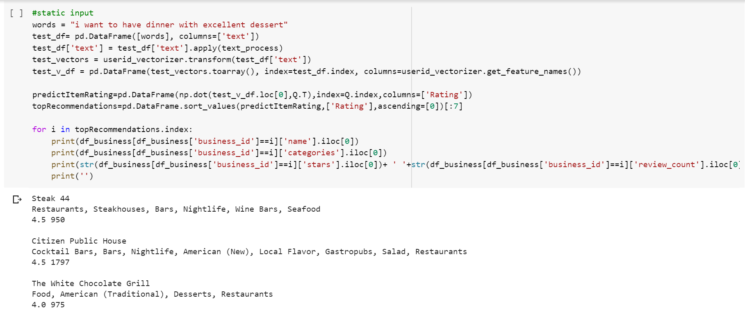
RESULTS
(Static Input):
Output :

Slide 13
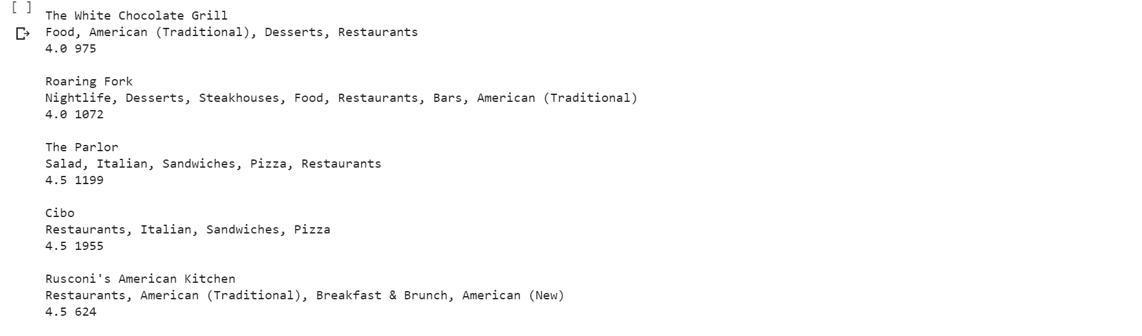

Slide 14
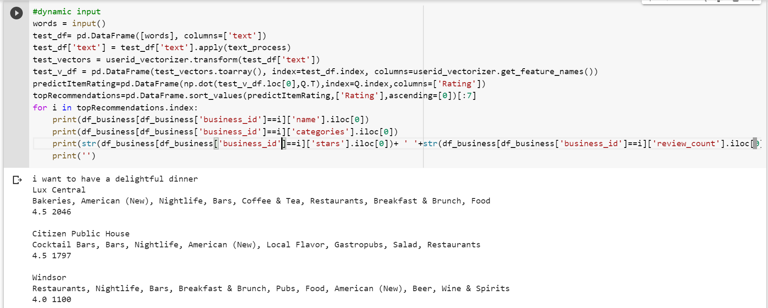
(Dynamic Input)
Input : words = input()
I want to have a delightful dinner
Output :

Slide 15
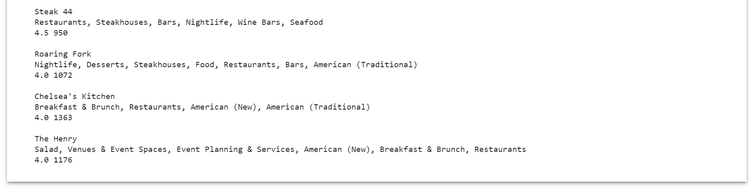

Slide 16
CONCLUSION
The project Restaurant Recommendation System was built by using latent factor collaborative filtering or matrix factorization.
In this project, we developed a model that could recommend the restaurant based on the choice of the user’s interest.

Slide 17
THANK YOU

